Slide 1
INTRODUCTION TO COMPUTING
Course Code: CCINCOM/L
Sorting Algorithms
Joseph Marvin R. Imperial
Faculty
Department of Computer Science
College of Computing and Information Technologies (CCIT)
National University
Joseph Marvin R. Imperial
ALGORITHMS AND COMPLEXITY
NU College of Computing and Information Technologies
Course Code: ALGOCOM

Slide 2
Quick Sort
A sorting algorithm that follows Divide and Conquer method.
It is dividing elements in to smaller parts based on some condition and performing the sort operations on those divided smaller parts. Hence, it works well for large datasets.
ALGORITHMS AND COMPLEXITY
Course Code: ALGOCOM

Slide 3
Quick Sort (Animated)
ALGORITHMS AND COMPLEXITY
Course Code: ALGOCOM

Slide 4
Quick Sort
First select an element which is to be called as pivot element.
Next, compare all array elements with the selected pivot element and arrange them in such a way that, elements less than the pivot element are to it's left and greater than pivot is to it's right.
Finally, perform the same operations on left and right side elements to the pivot element.
ALGORITHMS AND COMPLEXITY
Course Code: ALGOCOM

Slide 5
Quick Sort Pseudocode
Quicksort(A as array, low as int, high as int){
if (low < high){
pivot_location = Partition(A,low,high)
Quicksort(A,low, pivot_location)
Quicksort(A, pivot_location + 1, high)
}
}
Partition(A as array, low as int, high as int){
pivot = A[low] leftwall = low
for i = low + 1 to high{
if (A[i] < pivot) then{
swap(A[i], A[leftwall + 1])
leftwall = leftwall + 1
}
}
swap(pivot,A[leftwall])
return (leftwall)
}
ALGORITHMS AND COMPLEXITY
Course Code: ALGOCOM

Slide 6
Merge Sort
A sorting algorithm that follows Divide and Conquer method.
Works by dividing the list into the smallest unit (1 element), then comparing each element with the adjacent list to sort and merge the two adjacent lists. Finally all the elements are sorted and merged.
ALGORITHMS AND COMPLEXITY
Course Code: ALGOCOM

Slide 7
Merge Sort Algorithm
Divide the unsorted list into n sublists, each containing one element (a list of one element is considered sorted).
Repeatedly merge sublists to produce new sorted sublists until there is only one sublist remaining. This will be the sorted list.
ALGORITHMS AND COMPLEXITY
Course Code: ALGOCOM

Slide 8
Merge Sort (Animated)
ALGORITHMS AND COMPLEXITY
Course Code: ALGOCOM

Slide 9
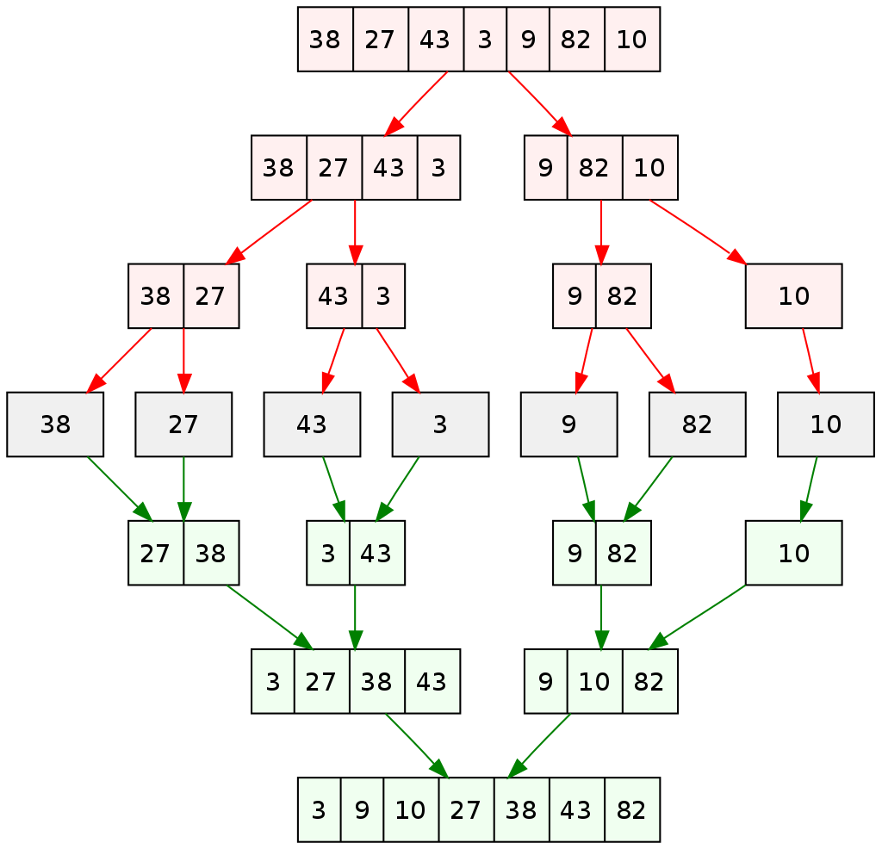
ALGORITHMS AND COMPLEXITY
Course Code: ALGOCOM

Slide 10
Merge Sort (Animated)
ALGORITHMS AND COMPLEXITY
Course Code: ALGOCOM

Slide 11
Merge Sort Analysis
In sorting n objects, merge sort has an average and worst-case performance of O(n log n).
If the running time of merge sort for a list of length n is T(n), then the recurrence T(n) = 2T(n/2) + n follows from the definition of the algorithm.
Case 2 of Master Theorem which is O(n log n).
Time complexity of Merge Sort is O (n log n) in all 3 cases (worst, average and best) as merge sort always divides the array in two halves and take linear time to merge two halves.
ALGORITHMS AND COMPLEXITY
Course Code: ALGOCOM

Slide 12
Shell Sort
A variation of insertion sort.
The idea of shell sort is to allow exchange of far items using a gap (h).
We make the array h-sorted for a value of h. We keep reducing the value of h until it becomes 1.
Starting with far apart elements, it can move some out-of-place elements into position faster.
ALGORITHMS AND COMPLEXITY
Course Code: ALGOCOM

Slide 13
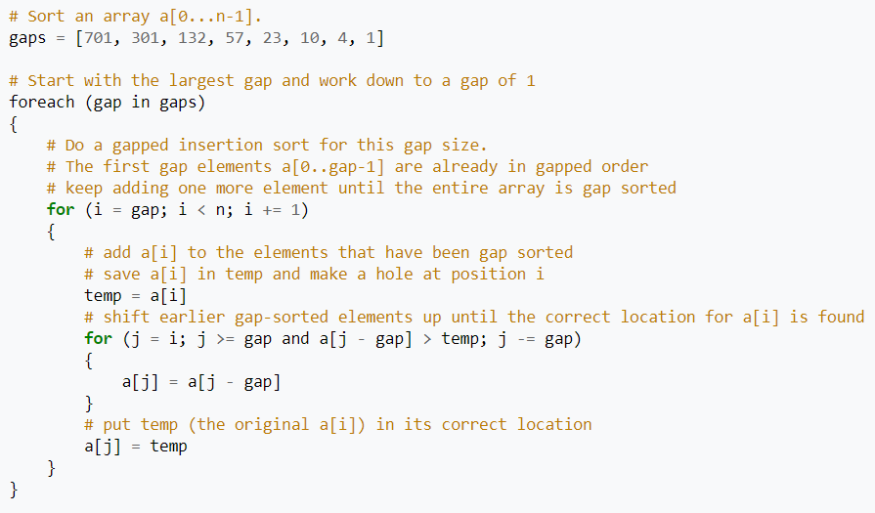
Shell Sort Pseudocode
ALGORITHMS AND COMPLEXITY
Course Code: ALGOCOM

Slide 14
Shell Sort Analysis
The running time of shell sort is heavily dependent on the gap sequence it uses. For many practical variants, determining their time complexity remains an open problem.
Too few gaps slows down the passes, and too many gaps produces an overhead.
O(n²) (worst known gap sequence)
O(n log₂n) (best known gap sequence)
ALGORITHMS AND COMPLEXITY
Course Code: ALGOCOM

Slide 15
Heap Sort
based on binary heap data structure.
we first find the maximum element and place the maximum element at the end.
iteratively shrinks the unsorted region by extracting the largest element and moving that to the sorted region.
more like an improved selection sort.
ALGORITHMS AND COMPLEXITY
Course Code: ALGOCOM

Slide 16
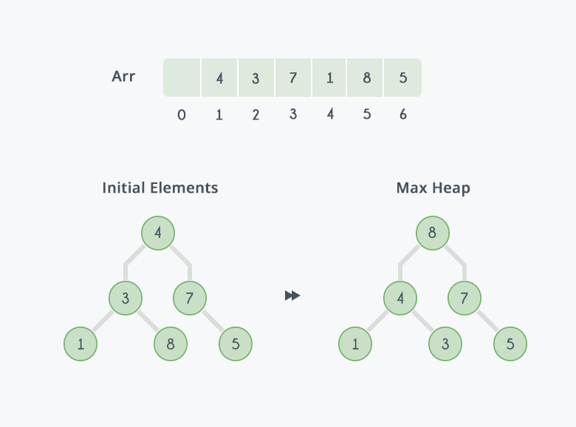
Building heap
ALGORITHMS AND COMPLEXITY
Course Code: ALGOCOM

Slide 17
Heap Sort Visualized
ALGORITHMS AND COMPLEXITY
Course Code: ALGOCOM

